Slide 1
A.I. Driven System for Traffic Violation and Detection
Shristi Gusain Univ Roll: 2218050 Student Id: 22011203
Section: G
Nidhi Kaintura Univ Roll: 2118830 Student Id: 21012051
Section: G

Slide 2
OBJECTIVES
The primary objective of this project is to design and implement a real-time AI-based traffic violation detection system using YOLOv5. The system should be capable of automatically analyzing video feeds and identifying specific traffic rule violations with minimal human intervention.
Objective 1: Develop a Real-Time Object Detection System Using YOLOv5
The core technical objective of this project is to implement a real-time object detection system capable of identifying relevant traffic entities—primarily motorbikes, helmets, and traffic direction—directly from video footage. YOLOv5, a high-speed and accurate object detection model, has been chosen for its balance between performance and speed.

Slide 3
Objective 2: Detect and Classify Specific Traffic Violations This system focuses on detecting two critical violations in its initial phase:
Helmetless Riding: Identifying two-wheeler riders without helmets using object class detection and spatial correlation (bike + no helmet).
Number Plate Detection : Detecting the number plate of the one violating the rule.
E – challan : Sending the e-challan
Objective 3: Integrate with a Graphical User Interface (GUI) To make the system accessible to non-technical users (e.g., traffic police or analysts), a user-friendly GUI is developed using Tkinter. The GUI allows:
Uploading of video files from surveillance cameras.
Real-time or post-processing of footage for violations.
Displaying flagged frames with bounding boxes and labels.
Report generation and export of violation logs for documentation or legal purposes.
Outcome: Provide intuitive system usability to end-users without needing to interact with code.

Slide 4
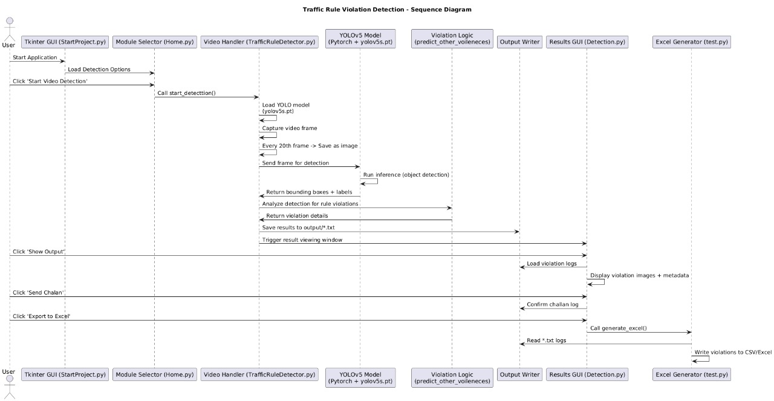
SEQUENCE DIAGRAM

Slide 5
METHODOLOGY
Graphical User Interface (GUI):
The entry point for users is a GUI built using Python’s Tkinter module. The interface is designed with PAGE GUI builder, generating necessary boilerplate for window handling and event binding. Scripts like StartProject.py, Home.py, and Detection.py form the interactive layer, allowing users to launch detection modules, view results, and export data.
Detection Engine:
The core detection logic resides in TrafficRuleDetector.py. Here, OpenCV captures frames from a video stream, storing every 20th frame as an image. This helps reduce computational load while still maintaining detection relevance. The saved frames are passed to the YOLO model for inference. Another important file is object_detection.py, which contains the neural network architecture components, bounding box utilities, and custom logic to detect violations.

Slide 6
METHODOLOGY
YOLOv5 Integration: YOLOv5s (small variant) is utilized here. This pretrained model is downloaded using download_weights.sh script which fetches weights like yolov5s.pt. The model is not custom-trained but used in its pretrained form on the COCO dataset which includes classes like ‘person’, ‘motorcycle’, ‘bicycle’, and ‘helmet’. These predictions are parsed using logic defined in the predict_other_voileneces() function to determine rule violations.
Prediction & Logic:
Detected objects from YOLO are compared based on presence and positions. If a ‘motorcycle’ is detected with a ‘person’ but without a ‘helmet’, it's considered a violation. Similarly, for wrong-way detection, orientation and motion can be analyzed (future enhancement). The logic filters and flags each frame, saving the decision in output/ folder as text files.
Visualization and Reporting: Detected frames and logs are displayed through a GUI (Detection.py). Users can choose to ‘send challan’, ‘view outputs’, or ‘export to Excel’. The script test.py consolidates all .txt logs into an .xls file. This final report can serve as legal or administrative proof.

Slide 7
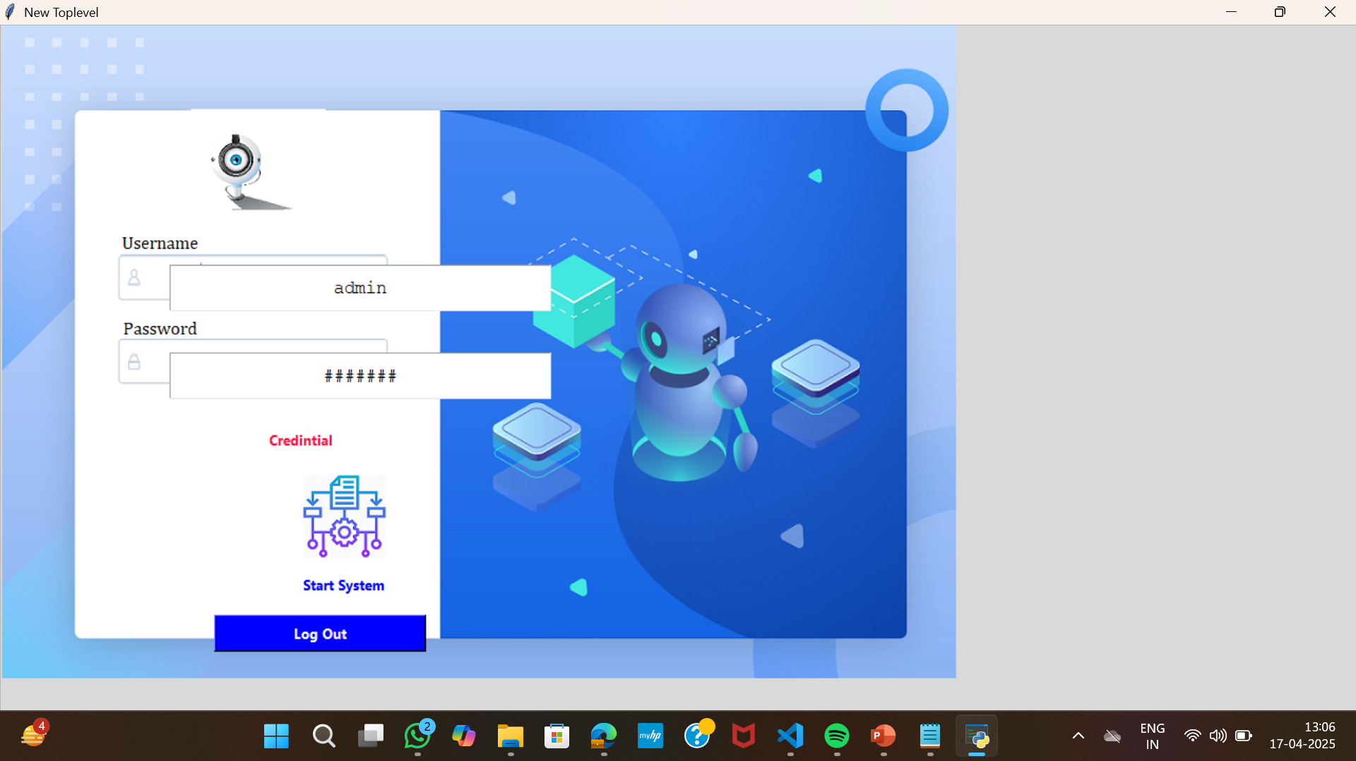
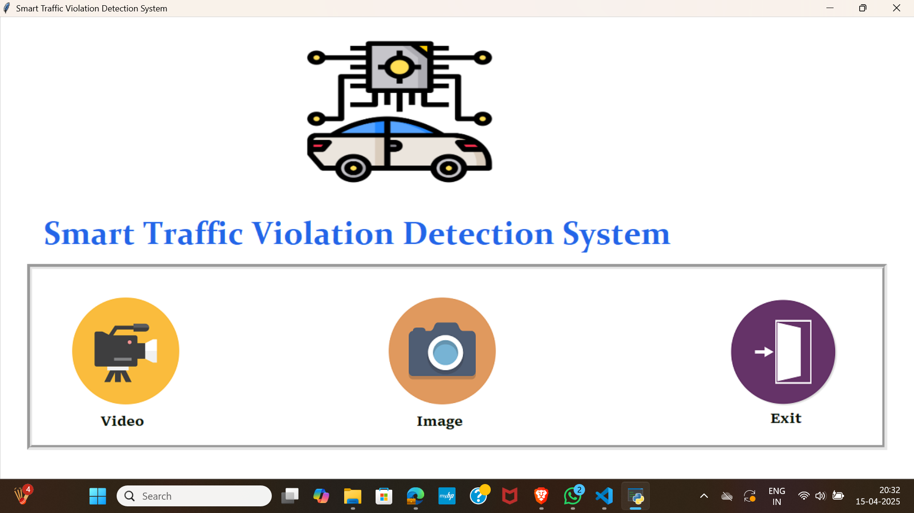
IMPLEMENTATION

Slide 8
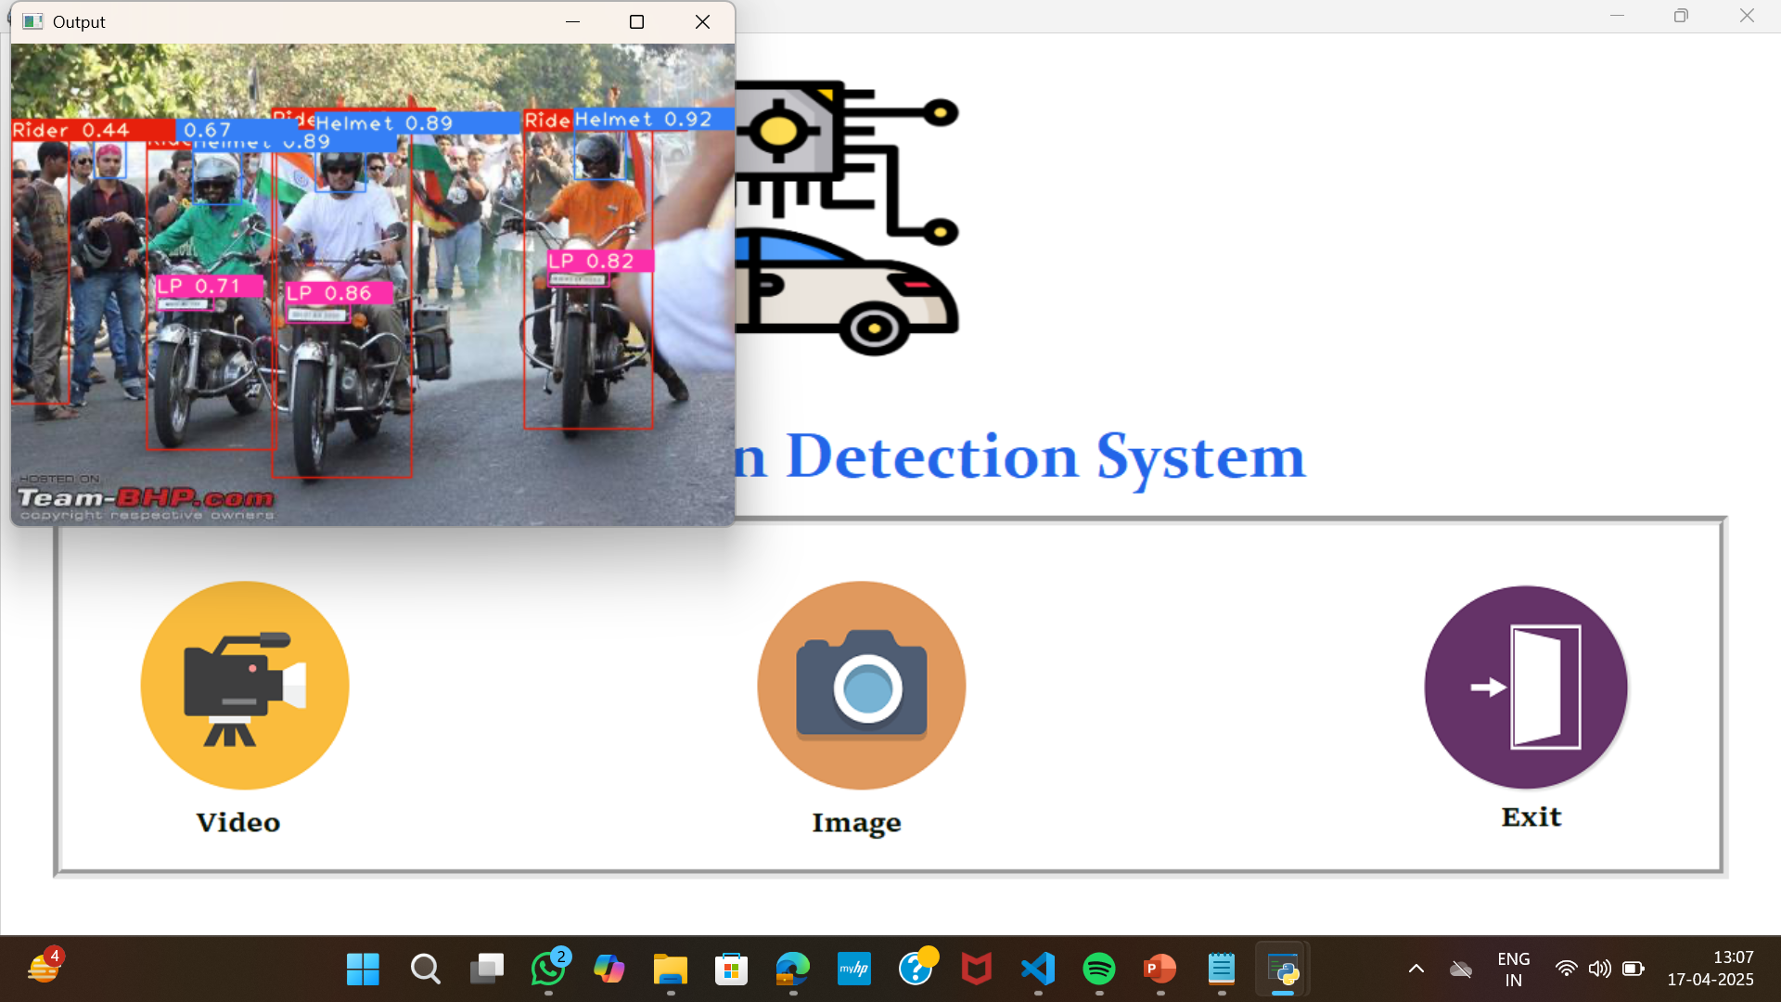
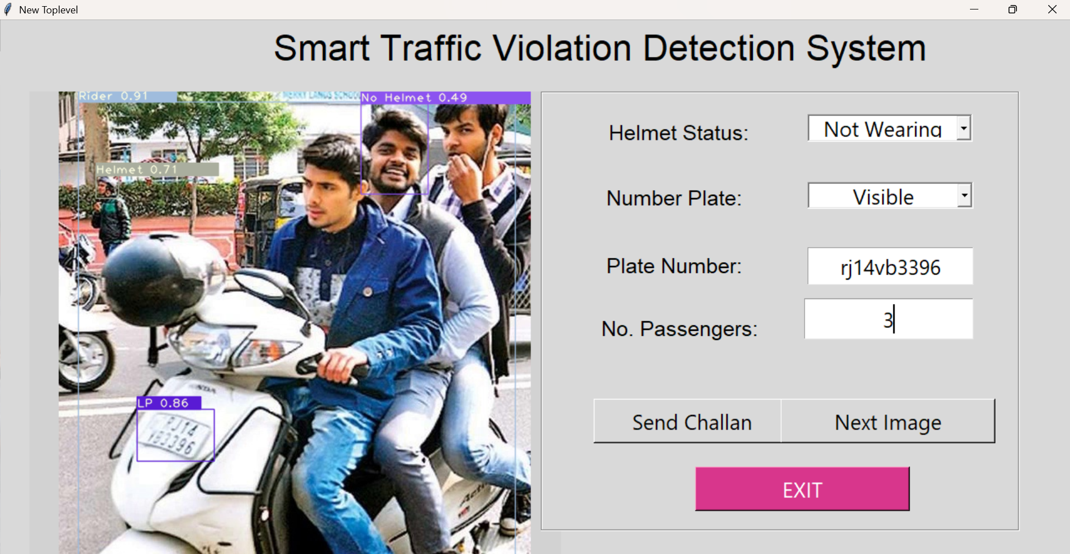
IMPLEMENTATION

Slide 9
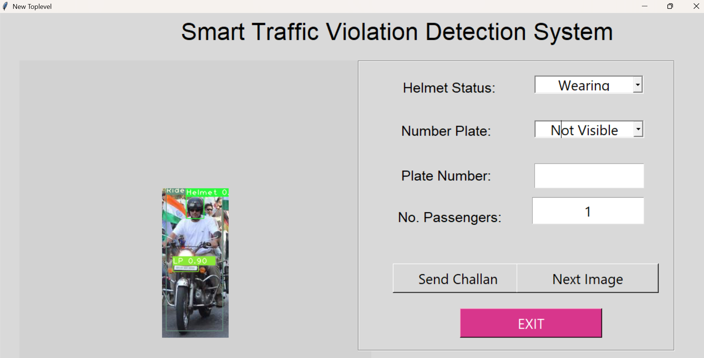
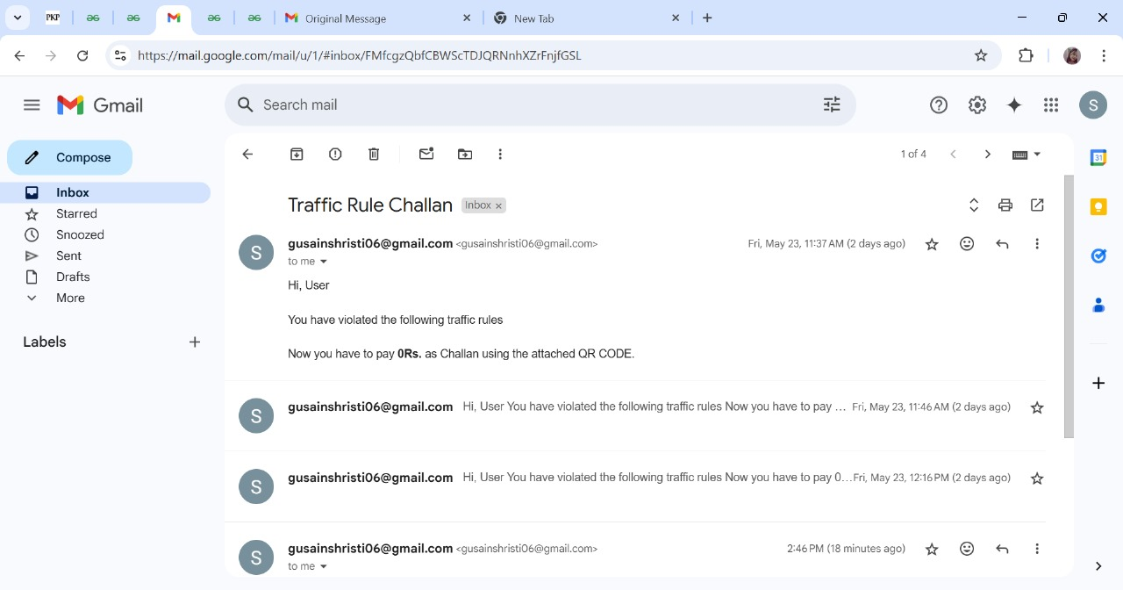
IMPLEMENTATION

Slide 10
FUTURE SCOPE
The current system lays a strong foundation for automated traffic violation detection and challan generation. To enhance its capabilities and scale for real-world deployment, the following future improvements and extensions can be considered:
1. Real-Time Video Surveillance Integration
2. Enhanced AI Models
3. Integration with Government Databases
4. GPS and Location Tracking
5. Automatic Fine Payment System
6. Edge Device Deployment
Establish a Scalable and Modular System for Future Expansion Although the current focus is limited to two types of violations, the system is designed with scalability in mind. The architecture is modular, allowing easy inclusion of additional features and violation types such as:
Red-light jumping
Triple riding on two-wheelers
Lane indiscipline
Mobile phone usage while driving

Slide 11
THANK YOU

